Slide 1
DRIVER TRAINING
HANDOUT
Updated as on Feb 14, 2020

Slide 2
CONTENTS
BS6 Fundamentals
Emission Standard
Emission Control – AL Approach
Instrument cluster and Tell-tale
Understanding the Tell-tale
Understanding the Tell-tale specific to Exhaust System
HEST (High Exhaust System Temperature) Lamp
Regeneration inhibit indication Lamp
Regen Inhibit Switch
DPF Lamp
Parked Regeneration – Precautions, Necessary Conditions, Parked Regeneration Switch
AdBlue Low level indication Lamp
NOx Lamp
MIL Malfunction Indication Lamp
Understanding Other Tell-tale (Safety and Performance)
EDC Lamp
Low air pressure/Brake failure/Park Brake
Parking Brake Release
Air filter blocked indicator
Low Coolant Level warning
Water in Fuel
LCD screen navigation
Switches and control
ECU controlled Exhaust brake
Down hill Driving
Information on Isolator switch
Head Lamp High Beam – Better Visibility
BS6 Diesel & AdBlue
Tank Cap Locking and Removal Procedure
Maintaining Fuel Level
Fuel Economy (Sweet Spot Driving)
If Vehicle is Not Starting

Slide 3
1.
BS6 – Emission Standard
CO
4.5
NOx
8.0
CO
1.5
NOx
3.5
BS I
BS IV
HC
1.1
PM
0.36
HC
0.46
PM
0.02
% Reduction
(BS I to BS VI)
NOx – 95 %
PM – 97 %
CO – 67 %
HC – 88 %
% Reduction
(BS IV to BS VI)
NOx – 88.5 %
PM – 50 %
CO – 0%
HC – 72 %
CO
1.5
NOx
0.4
BS VI
HC
0.13
PM
0.01
Huge reduction of Nox, PM and HC

Slide 4
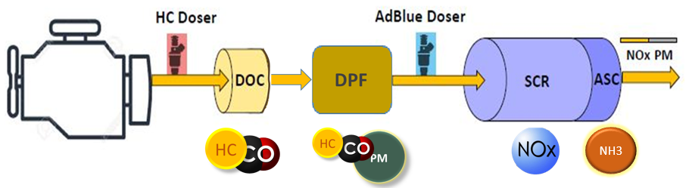
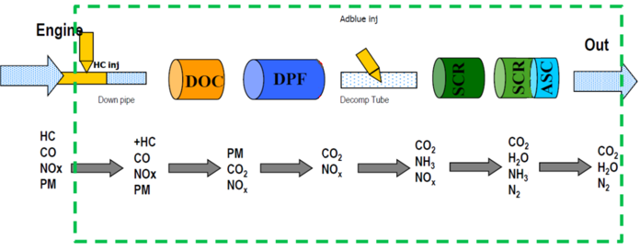
1.
BS6 – Emission Control – AL Approach
Diesel Particulate Filter where particles (soot) from engines is captured.
Regeneration is the in vehicle cleaning process for Diesel Particulate filter
In the SCR, a pump dozes AdBlue for removing Nox from the Exhaust Gases
Wrong quality of AdBlue can result in Errors in functioning of EATS

Slide 5
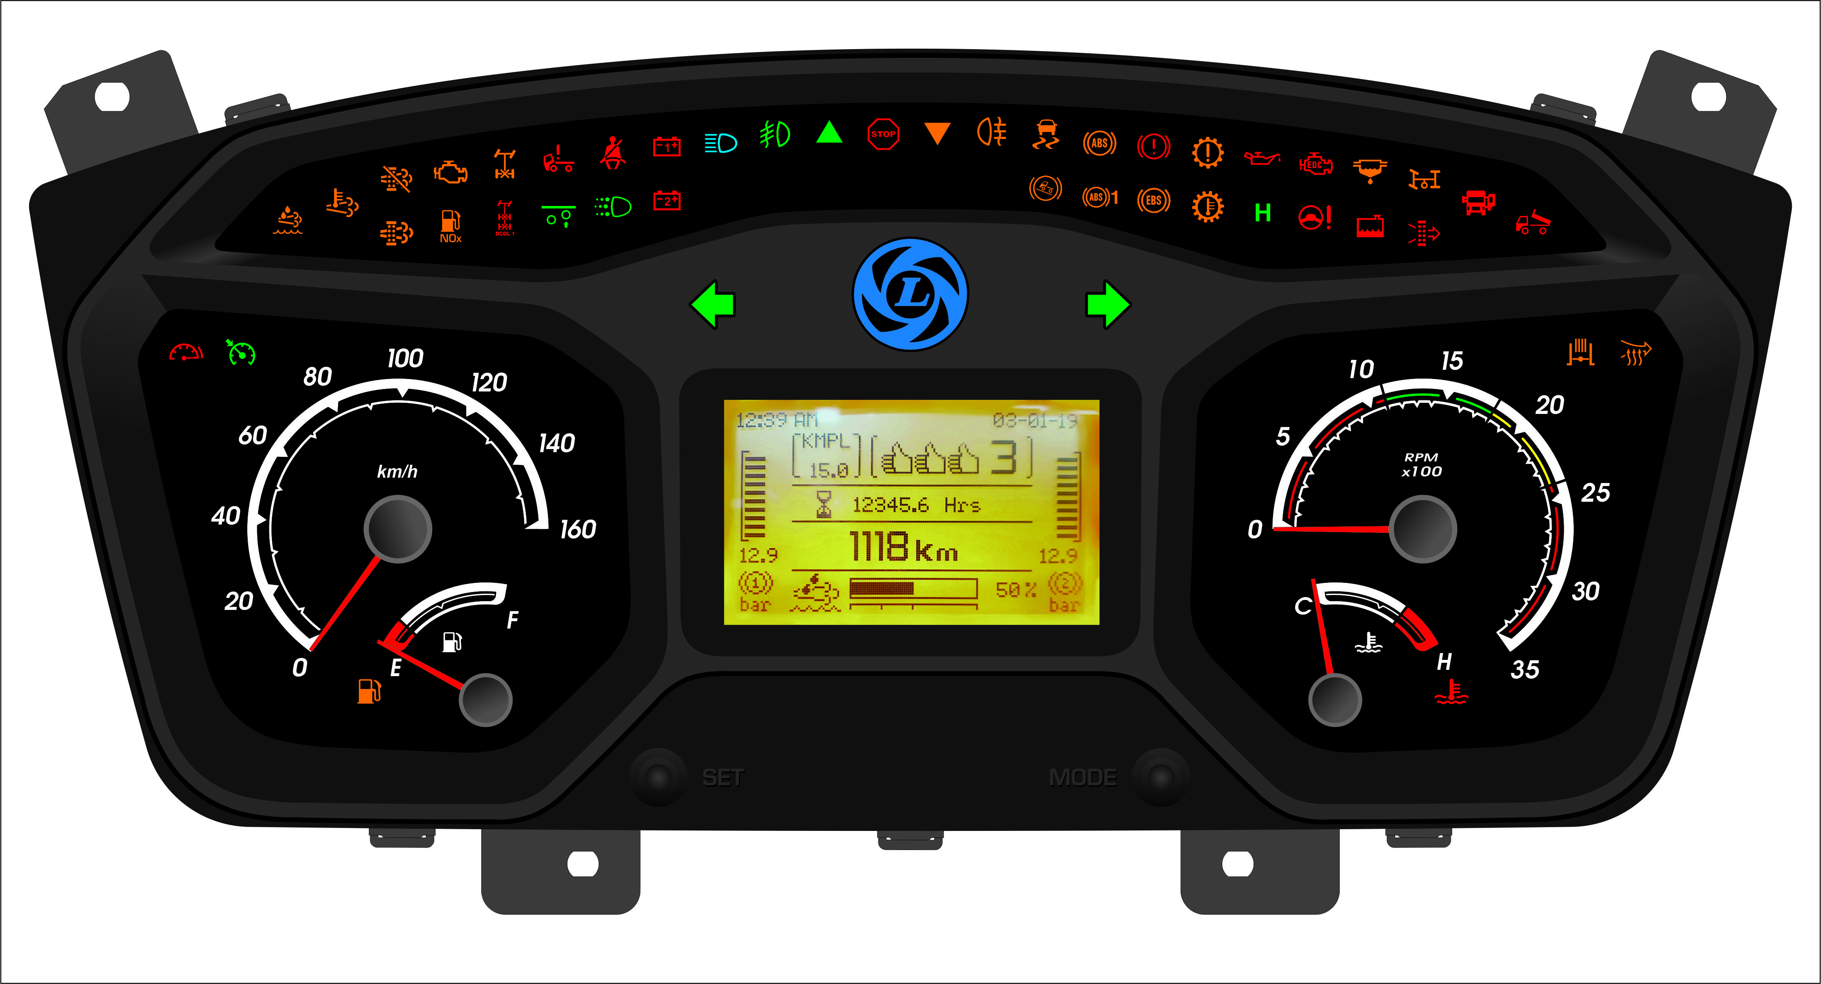
2.
Instrument cluster and Tell-tale

Slide 6













Instrument cluster and Tell-tale
Critical Alert Tell tale that requires attention from Driver
2.
Emission
Safety
Performance
Switches
High Exhaust System Temperature
Stop Lamp
OFF
EDC Lamp
Regeneration Inhibit Switch
DPF regeneration inhibit
Water in Fuel indicator
ON
DPF Lamp (Regen needed)
Low air pressure / Parking brake ON
Press for more than 5 seconds
Parked Regeneration Switch
Low AdBlue warning
Air filter blocked indicator
Air pressure gauges in LCD Screen
NOx related error
Low coolant level warning
MIL
Low fuel level warning

Slide 7
Instrument cluster and Tell-tale
Understanding the Tell-tale specific to exhaust system
2.
High Exhaust System Temperature
Effect on vehicle:
No effect
Condition:
This indicates regeneration is happening in vehicle
Regeneration is the cleaning process for Diesel Particulate filter in the Exhaust System
Driver action:
Drive the vehicle away from flammable substance or heavy traffic immediately
If above is not possible, press the Regen Inhibit Switch

Slide 8
Instrument cluster and Tell-tale
Understanding the Tell-tale specific to exhaust system
2.
DPF Regen Inhibit ON
Effect on vehicle:
No effect
Condition:
When Regeneration inhibit switch is switched ON by driver due to unfavorable surrounding.
Regeneration inhibit switch
When switch is turned ON, DPF regen will be inhibited.
Driver action:
When Inhibit switch is NOT switched ON and DPF regen inhibit telltale is ON, contact the nearby authorized Ashok Leyland Service Centre.

Slide 9

Regen Inhibit Switch - Usage
Regeneration Inhibit Switch
OFF
Inhibit switch is a normal ON/OFF type switch which is used to stop any DPF regeneration (Regeneration can happen on its own while the vehicle is moving or can be initiated by the Driver on a Parked vehicle, when necessary)
It can be used whenever driver foresees any safety concerns during DPF regeneration in flammable environment (eg. fuel filling station / grassy / forest areas where high exhaust temperature can be exposed to flammable materials like dry grass etc. on the ground).
ON
When inhibit switch is ON, inhibit lamp tell tale on dashboard will glow.
Apart from that, LCD message will indicate “Inhibit switch active – DPF regeneration inhibited”.
Do not use inhibit switch unless it is required. Otherwise DPF will accumulate excess soot load over a period of time which will result in Low Pickup and Engine Shutdown in extreme condition. The DPF would require cleaning at authorized Ashok Leyland Service Centre.

Slide 10
Instrument cluster and Tell-tale
Understanding the Tell-tale specific to exhaust system
2.
DPF Lamp
Effect on vehicle:
No effect
Level 1
DPF lamp solid ON
Condition:
When Diesel Particulate Filter (DPF) is choked and needs regeneration
Driver action:
Drive the vehicle on a highway at high speed to increase exhaust system temperature.
If the above condition is not possible, park vehicle in a safe location to start Parked regeneration.

Slide 11
Instrument cluster and Tell-tale
Understanding the Tell-tale specific to exhaust system
2.
DPF Lamp
Effect on vehicle:
Vehicle pick up would be low when DPF Lamp starts flashing along with EDC lamp ON
Level 2
DPF lamp flashing
Condition:
When Diesel Particulate Filter (DPF) is highly choked and parked regeneration has to be carried out at the earliest possible
Driver action:
Park the vehicle in a safe location to start Parked regeneration immediately.

Slide 12





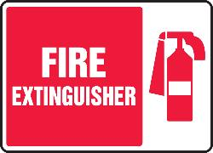





Parked Regeneration - Precautions
Precautions before attempting Parked regeneration:
Place wheel choke at the front and rear of at least one wheel
FLAMMABLE
FUEL STATION
Ensure the Fire Extinguisher is at easily accessible location and be aware of using it if required.
Ensure that the exhaust smoke does not come in contact with “dry grass, rags, grease, debris, fuel, oil soaked waste or any flammable substances” and also confirm that no such flammable substance is on or near the exhaust system, during parked regeneration.
During parked regeneration, stay near to the vehicle in order to supervise the procedure and prevent any object or person from coming close to the exhaust.
Verify hood/front opening panel is closed and latched.

Slide 13
Parked Regeneration – Necessary Conditions
Conditions to start Parked Regeneration:
Park the vehicle in a well ventilated area and away from other vehicles.
Ensure gear is in Neutral position
Switch OFF the AC if applicable
Apply Parking Brake - ON
Ensure PTO is switched OFF
Switch ON ignition, START the engine and then START the parked regeneration by pressing the Switch for more than 5 seconds
Engine RPM raises to 2000 RPM when parked regen is started
Do not press Accelerator pedal or any other switches / controls on Dashboard
Keep an eye on vehicle surroundings on all sides when the regeneration is happening
Press for more than 5 sec

Slide 14
Parked Regeneration
Parked Regeneration Switch ON
To activate Parked regeneration, press “START” (bottom side of switch) for more than 5 seconds and release.
To confirm whether parked regeneration activation switch has been pressed properly , please check the LCD message which indicates “Standstill regeneration switch ON” and if Engine RPM raises to 2000 RPM
After that, if all the other parked regeneration enable conditions are satisfied, then LCD message display as “Standstill DPF regeneration active through Switch”.
After that DPF regeneration can also be confirmed through HEST lamp activation.
Press for more than 5 sec
High exhaust system temperature
(Lamp Solid ON )

Slide 15
Parked Regeneration
Parked Regeneration Completion
Once the Regeneration is complete, the Engine RPM drops to Idle RPM.
Both LCD messages, “Standstill regeneration switch ON” and “Standstill DPF regeneration active” will not Display in LCD screen. Also after some time, HEST lamp goes OFF

Slide 16

Instrument cluster and Tell-tale
Understanding the Tell-tale specific to exhaust system
2.
DPF Lamp + MIL Lamp + Stop Lamp
Effect on vehicle:
Pick up will be Low and Engine will shutdown after some time when DPF Lamp starts flashing and MIL, red STOP lamp is ON
Level 3
MIL , STOP Lamp ON and DPF lamp flashing
Condition:
When Diesel Particulate Filter is choked completely
Driver action:
Not safe to drive vehicle. Park the vehicle immediately and contact the nearby authorized Ashok Leyland Service Centre.

Slide 17
Instrument cluster and Tell-tale
Understanding the Tell-tale specific to exhaust system
2.
Low AdBlue Warning
Level 1
Effect on vehicle:
No effect
AdBlue warning solid ON
Condition:
When AdBlue quantity is less than 10 %
Driver action:
Fill the recommended AdBlue solution immediately.
GULF AdBlue

Slide 18
Instrument cluster and Tell-tale
Understanding the Tell-tale specific to exhaust system
2.
Low AdBlue Warning
Level 2
Effect on vehicle:
Some time after this tell tale starts flashing, there would be Low Pick up
AdBlue warning flashing
Condition:
When AdBlue quantity is less than 5 % of total filling capacity and Low pick up when the level is less than 2.5%
Driver action:
Fill the recommended AdBlue solution immediately.
GULF AdBlue

Slide 19
Instrument cluster and Tell-tale
Understanding the Tell-tale specific to exhaust system
2.
NOx related Error
Effect on vehicle:
Some time after this tell tale glows, there would be Low Pick up
Condition:
DEF (Diesel Exhaust Fluid) Quality might be an issue
When errors related to Urea Dosing System happens
Driver action:
Contact the nearby authorized Ashok Leyland Service Centre.
Ensure only recommended Adblue solution is used.
Gulf AdBlue

Slide 20
Instrument cluster and Tell-tale
Understanding the Tell-tale specific to exhaust system
2.
MIL
Effect on vehicle:
Some time after this Tell-tale glows continuously during engine run, there would be Low Pick up.
Condition:
When MIL glows continuously during engine run, there may be error in Emission control
Driver action:
Contact the nearby authorized Ashok Leyland Service Centre

Slide 21
Instrument cluster and Tell-tale
Understanding the Tell-tale specific to Performance
2.
EDC Lamp
Effect on vehicle:
May reduce the Pick-up / Speed or Engine RPM
Condition:
When there is any abnormality with function of sensors or any electronic components controlled by ECU and Exhaust system
Driver action:
Contact the nearby authorized Ashok Leyland Service Centre

Slide 22
Instrument cluster and Tell-tale
Understanding the Tell-tale specific to Performance
2.
Water in fuel
Effect on vehicle:
Low Pick up
Condition:
When water gets collected in filter more than allowable limit
Driver action:
When the telltale starts blinking, drain the water from fuel filter cum water separator mounted on Engine as well as Pre filter mounted on chassis

Slide 23
Instrument cluster and Tell-tale
Understanding the Tell-tale specific to Performance
2.
Water in fuel
Effect on vehicle:
No effect
Condition:
When there is any error, issue in sensor or its wiring connection
Driver action:
When the tell tale glows continuously, Contact authorized Ashok Leyland Service Centre

Slide 24
Parking Brake Release
As a product improvement, the Brake system pressure has been increased in all BS6 MDV vehicles. In this new system, the Air Pressure cut out happens between 9.6 and 9.9 bar.
During every Air Pressure cut out (Air release sound), 0.6 bar pressure of air will be used to clean the system on its own and hence this pressure drop is normal.
Low pressure warning Beep sound and Telltale goes OFF when pressure reading in both Front Brake and Rear Brake gauges goes above 5 bar.
When the vehicle is in Parked Condition, the Vehicle cannot be moved immediately after Beep sound and Telltale goes OFF, please wait until pressure reaches 7.9 to 8.1 bar in both the gauges.
Low Pressure warning Beep sound and Telltales and switches ON when any of the gauge reading falls below 4.5 bar.
Air pressure gauges in LCD Screen

Slide 25
Instrument cluster and Tell-tale
Understanding the Tell-tale specific to Safety
2.
Effect on vehicle:
Safety issue and not recommended to drive with Low air pressure telltale ON
Low Air Pressure / Parking Brake
Conditions:
When Vehicle is Parked with Hand Brake ON:
Air pressure is less than 4.5 bar in Front or Rear Brake - STOP and Low air pressure Telltale glows together. Also, Beep sound would be audible
Air pressure is more than 5 bar in both the Brakes - Beep sound stops
Driver action:
On MDV BS6 Vehicles, Allow time for the Air pressure to build around 7.9 to 8.1 bar. On other vehicles, wait for the pressure to build around 5 to 5.5 bar. If Air pressure is not building, contact the nearby authorized Ashok Leyland Service Centre
Release the parking brake before moving the vehicle. The STOP and Low Air pressure Telltale goes OFF
When Vehicle is Running:
Air pressure is less than 4.5 bar in Front or Rear Brake - STOP and Low air pressure Telltale glows together. Beep sound also would be audible
Driver action:
Air pressure to be built above 5 bar on both gauges.

Slide 26
Instrument cluster and Tell-tale
Understanding the Tell-tale specific to Performance
2.
Air Filter Chocked
Effect on vehicle:
Low Pick up
Condition:
When Air filter is Chocked
Driver action:
Visit the nearby authorized Ashok Leyland Service Centre

Slide 27
Instrument cluster and Tell-tale
Understanding the Tell-tale specific to Performance
2.
Low Coolant Level
Effect on vehicle:
Would lead to engine overheating and consequent engine damage if coolant is not topped up immediately
Condition:
When coolant level in DAT is about to reach MIN level
Driver action:
Check for leakage, arrest and Top up the coolant
If leakage is not visible, top up the coolant and contact the nearby authorized Ashok Leyland Service Centre

Slide 28
Instrument cluster and Tell-tale
LCD screen navigation
2.
Contents
Screen 1: Home Page
Screen 2: Vehicle Info
Screen 3: Trip 1
Screen 4: Trip 2
Screen 5: Engine Diagnostics
Screen 6: After Treatment Diagnostics
Screen 7: ABS Diagnostics
Screen 8: Electrical Diagnostics
Screen 9: Warning
Screen 10: Information
Screen 11: Version Info - Cluster
Screen 12: Version Info - BCU
LCD screen
SET button
MODE button
Press MODE button to change the Screens Forward
Press SET button to change the Screens Backward

Slide 29
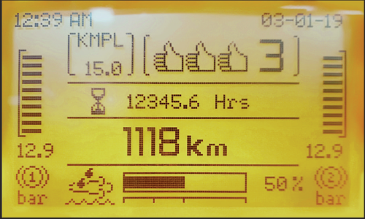
Instrument cluster and Tell-tale
LCD screen navigation
2.
Screen 1: Home screen
Time
Instantaneous KMPL
Gear Shift Sweet spot Indication
Total Engine Hours
Date
Gear indicator
Air pressure gauge 2
Adblue Level in Percentage
Odometer reading (km)
Air pressure gauge 1

Slide 30
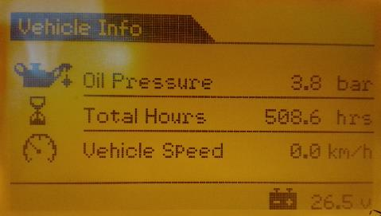
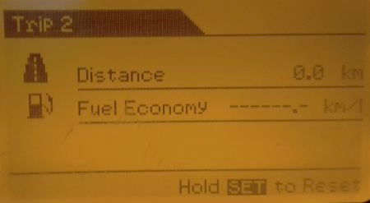
Instrument cluster and Tell-tale
LCD screen navigation
2.
Screen 2: Vehicle info screen
The information available in the Vehicle info screen
OIL PRESSURE in bar
VEHICLE SPEED in km/h
BATTERY VOLTAGE in V

Slide 31
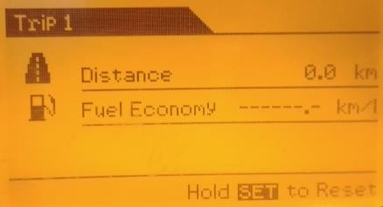
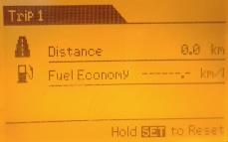
Instrument cluster and Tell-tale
LCD screen navigation
2.
Screen 3: Trip 1 details screen
The following information are displayed in the Trip 1 details screen
DISTANCE covered in km
FUEL ECONOMY in km/L
SET button
In Trip 1 details screen, hold SET button to reset the values.

Slide 32
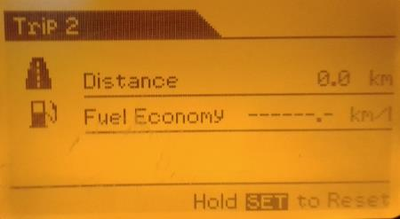

Instrument cluster and Tell-tale
LCD screen navigation
2.
Screen 4: Trip 2 details screen
The following information are displayed in the Trip 2 details screen
DISTANCE covered in km
FUEL ECONOMY in km/L
SET button
In Trip 2 details screen, hold SET button to reset the values.

Slide 33
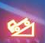
Switches and control
Exhaust Brake Actuation
3.
All BS6 Vehicles are equipped with Exhaust Brake. It is fitted after the Turbocharger in Exhaust line.
Exhaust Brake aids in controlling the Engine RPM while driving downhill.
Exhaust Brake is controlled by ECU (Engine Control Unit)
It works on its own at following conditions
When Downhill Support Switch is ON (Provided in Dashboard with symbol)
It works above 1800 rpm though the Service Brake is not pressed and the Accelerator pedal is not pressed
When Downhill Support Switch is ON or OFF (Provided in Dashboard with symbol)
It works above 1500 to 1800 rpm when the Service brake is pressed and the Accelerator pedal is not pressed
It works above 2650 rpm to 2800 rpm when the Service Brake is not pressed and the Accelerator pedal is in any position (All the telltale blinks at this point and also LCD screen display would be “Apply Brake Immediately”. The Service Brake has to be immediately applied)
Always ensure to switch ON the Downhill Support switch while driving down a slope

Slide 34
Switches and control
Down Hill Driving
3.
Always ensure to switch ON the Downhill Support Switch in Dashboard with symbol while driving down a slope
While driving the vehicle in long downhill, please drive in same gear that will be used to climb the slope
Ensure not to down shift by more than 1 gear at a time
Ensure not to ride the clutch while you are partially applying the service brake
Apply Service brake as and when required to control the vehicle speed to less than 30 Kmph as well as Engine RPM to be less than 2000 rpm. Downshifting without applying the Service brake could cause the Engine RPM to raise beyond the specified limit and would lead to severe damage to Engine components
You have to immediately apply Service brake when all the telltale flickers, to control Engine RPM

Slide 35
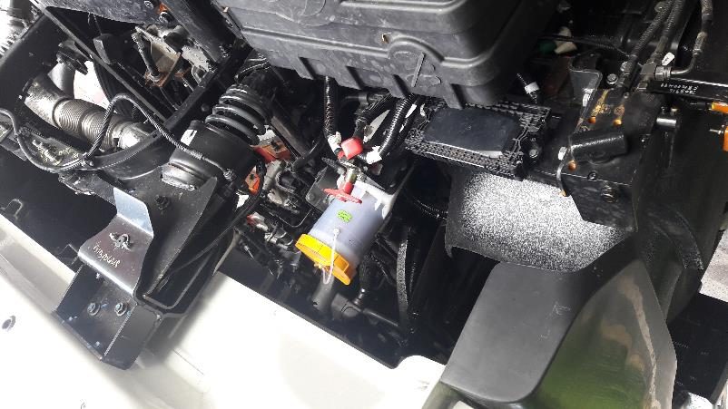
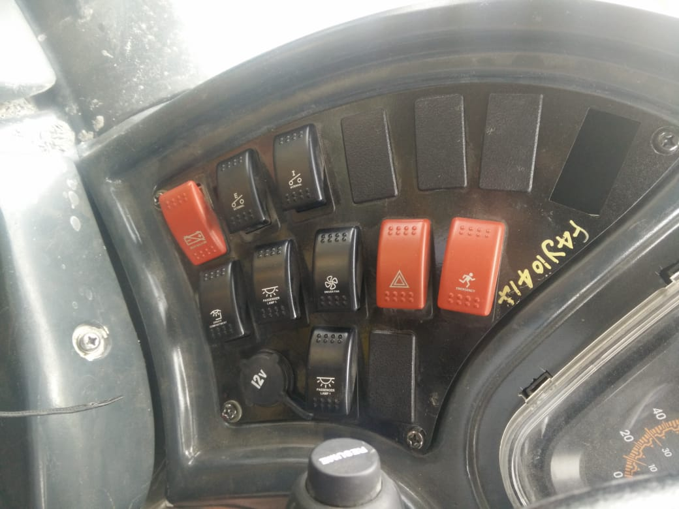
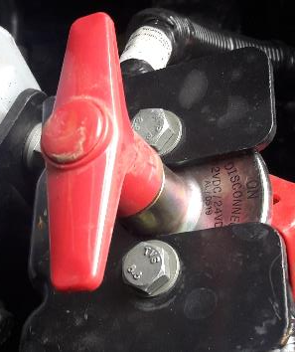
Switches and control
Isolator Switch
3.
Isolator Switch has to be switched OFF in case of i) any emergency situation involving Electricals or Diesel and ii) long storage of vehicle
Isolator switch has to be switched OFF only after 90 seconds of Ignition Key OFF. If not done so, Exhaust After Treatment System may malfunction / fail and result in Low Torque (The switch shown is in OFF condition)
Isolator switch is located on Back side of Cabin close to Battery on all MDV BS6 Trucks
Isolator switch is located in Dashboard on left side of Instrument Cluster on ICV Bus

Slide 36

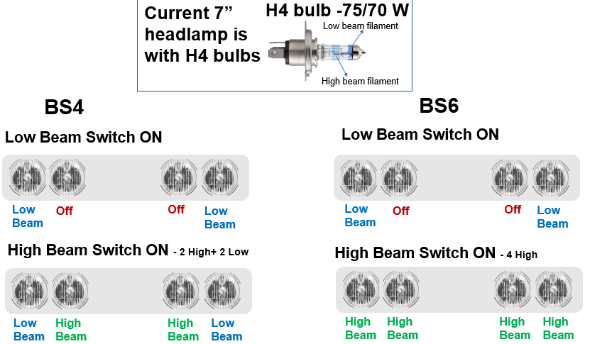
High Beam – Better Visibility
4.
When High beam is selected by Combination switch, all four headlamps will glow in High beam on BS6 MDV trucks.
This will improve the visibility during Night time driving at par with the current field practices

Slide 37
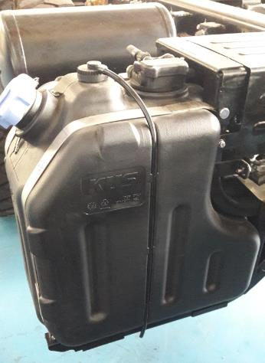
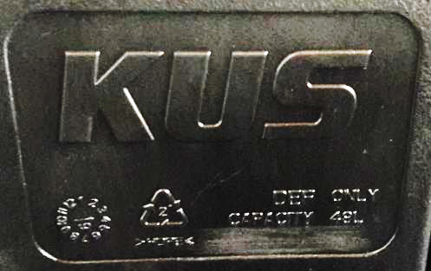
BS6 Diesel & AdBlue
5.
BS6 Diesel
Please Use Only BS6 Diesel for all Ashok Leyland Trucks and Buses
The amount of Sulphur is reduced by 80% in BS6 diesel (50 ppm to 10 ppm) when compared to BS4 diesel
Usage of BS4 Diesel on BS6 Trucks or Buses would affect the life of DPF in Silencer.
Consequently pick up of vehicle would be affected and result in huge cost of Repair
AdBlue
Please fill only AL recommended AdBlue (Gulf – AUS32)
Fill only the quantity as recommended on RH side of AdBlue tank (48 litres / 24 litres) (Refer Pictures)
Never run the vehicle without AdBlue tank Cap or not closed properly to prevent crystallization of AdBlue.
Never run the vehicle without AdBlue as it will lead to Low Pick up of the vehicle

Slide 38
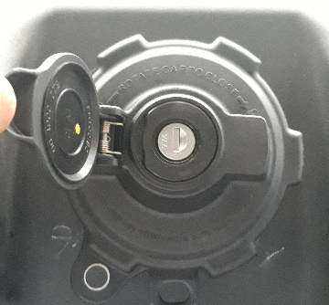
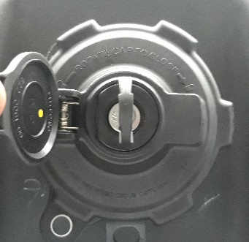
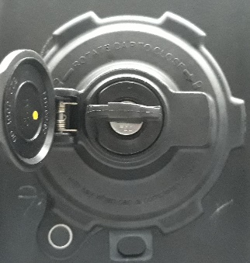
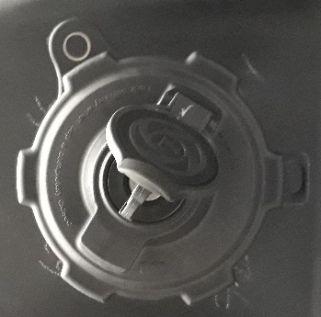
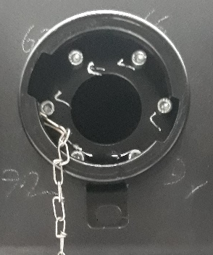
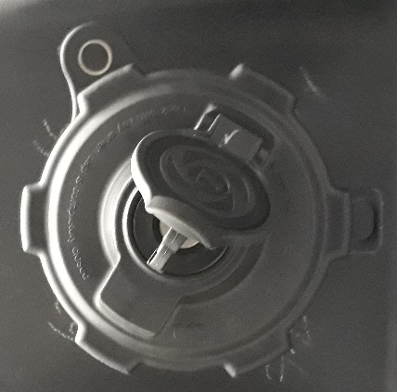
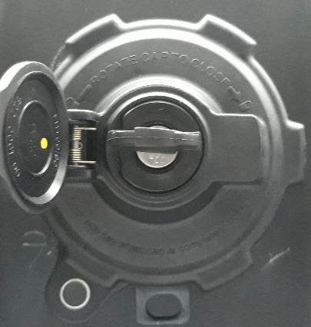
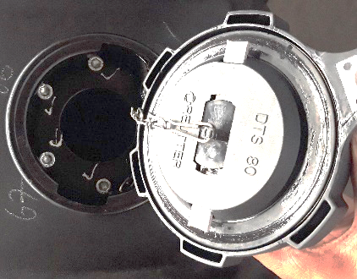
BS6 Diesel & AdBlue
5.
Diesel Tank Cap Removal & Fitment
Removal Step 1
Removal Step 2
Removal Step 3
Lift Dust Protection Cap and Insert Diesel tank Key
Rotate the Key
90° Anti-clock wise
Rotate Cap Anti-clock wise to the end & remove from tank
Rotate cap clock wise until it will not rotate further
Rotate Key 90°
Clock wise & remove Key. Rotate the Cap anti clockwise for 2 rotations and verify the cap does not come out
Fix the cap by matching the slot
Fitment Step 1
Fitment Step 2
Fitment Step 3

Slide 39
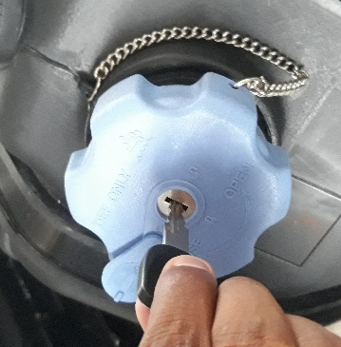
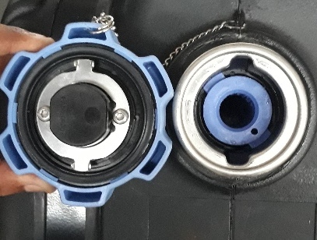
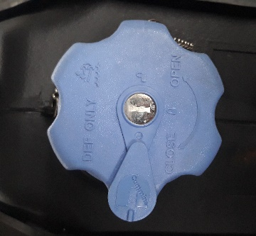
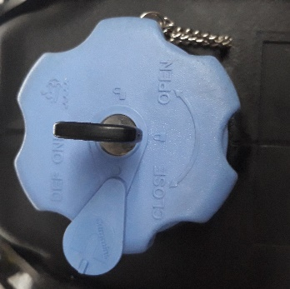
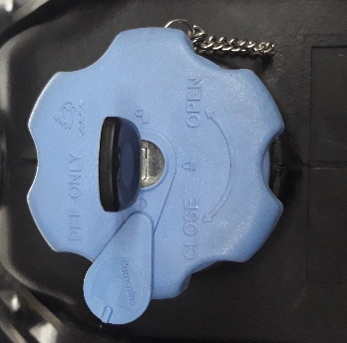
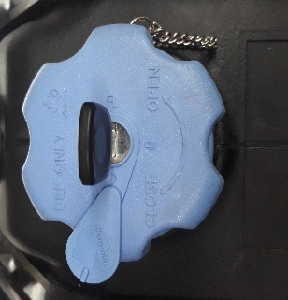
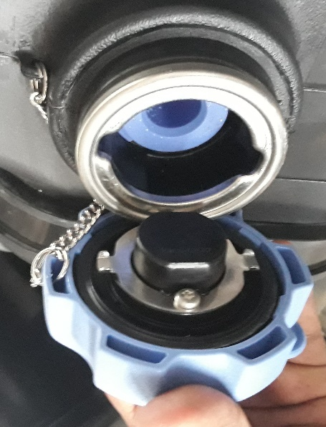
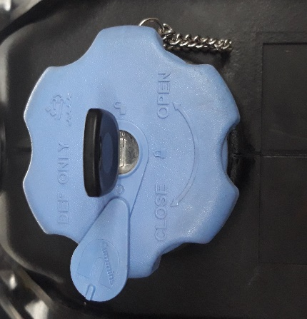

BS6 Diesel & AdBlue
5.
DEF Tank Cap Removal & Fitment
Removal Step 1
Removal Step 2
Removal Step 3
Slide the latch and Insert the DEF tank Key
Rotate the Key
90° Anti-clock wise
Rotate Cap Anti-clock wise to the end & remove from tank
Rotate cap clock wise until it will not rotate further
Rotate Key 90°
Clock wise & remove Key. Rotate the Cap anti clockwise for 2 rotations and verify the cap does not come out
Fix Cap by matching the slot
Fitment Step 1
Fitment Step 2
Fitment Step 3

Slide 40

Maintaining Fuel Level
6.
Low Fuel Level
Effect on vehicle:
If we continue to run the vehicle without filling up BS6 diesel, it would lead to Air lock situation
Condition:
When Fuel level in Fuel tank reaches 20% of its volume
The left over volume in Fuel depends on Capacity of tank fitted (i.e., 375 litres capacity tank has the maximum advantage)
Driver action:
Drive the vehicle to nearest Fuel Station with BS6 Diesel and fill the fuel
Ensure to fill to avoid Air lock situation
Ensure only BS6 Diesel is filled, BS4 Diesel will affect the Exhaust After Treatment system

Slide 41
Fuel Economy (Sweet Spot Driving)
7.
 | N4 Engine | H6 200HP Engine
Fuel Economy Band | 1200 rpm to 1600 rpm | 1200 rpm to 1600 rpm

Slide 42
If Vehicle is not Starting
8.
If starter motor works and engine is not starting, check for the following
Check for fuel availability in Diesel tank
Remove air lock by using hand primer on Pre- filter mounted on Chassis.
Check for leak or kink in fuel supply hoses/joints and rectify
Contact the nearby authorized Ashok Leyland Service Centre.
If starter motor itself does not crank, check for following
Condition of Fuses in Main fuse box located in front of Co-driver seat. (Refer Fuse layout sticker on Fuse cover)
Check for tightness of Battery earth (Ground) connection bolt as follows
Check for Starter motor earth (Ground) connection in FSM
Contact the nearby authorized Ashok Leyland Service Centre.
Vehicle | Fuse to be checked
MDV Trucks | F06, F10, FM8 and F34
ICV Trucks | F06
MDV and ICV Bus | F21 (ICV Bus), F47 (MDV Bus)
Vehicle | Location
MDV Trucks | Below Cab Rear end in Co-Driver Side
ICV Trucks | Near Battery Carrier in LHS Frame Side member
MDV and ICV Bus | Inside the Bonnet, close to FIP
Vehicle | Battery Earth Location
MDV Trucks | Close to the Battery Carrier
ICV Trucks | Behind Battery Carrier
MDV and ICV Bus | Close to the Battery Carrier

Slide 43
THANK YOU

